Slide 1
Finite-State Machines (FSMs) and Controllers

Slide 2
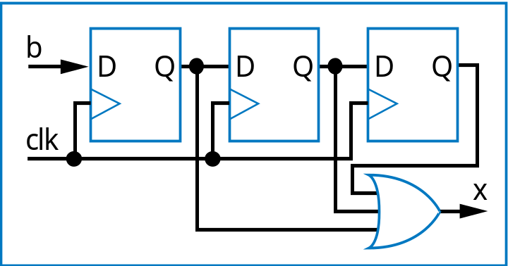
Finite-State Machines (FSMs) and Controllers
Want sequential circuit with particular behavior over time
Example: Laser timer
  Push button: x=1 for 3 clock cycles
  How? Let’s try three flip-flops
    b=1 gets stored in first D flip-flop
    Then 2nd flip-flop on next cycle, then 3rd flip-flop on next
    OR the three flip-flop outputs, so x should be 1 for three cycles
b
Controller
x
laser
clk
patient

Slide 3
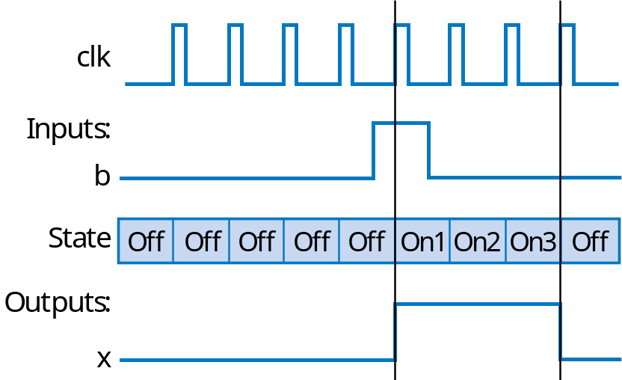
Extend FSM to Three-Cycles High Laser Timer
Four states
Wait in “Off” state while b is 0 (b’)
When b is 1 (and rising clock edge), transition to On1
  Sets x=1
  On next two clock edges, transition to On2, then On3, which also set x=1
So x=1 for three cycles after button pressed
Inputs: b; Outputs: x
x=0
clk
^
O
ff
b
’*clk
^
b*clk
^
x=1
clk
^
x=1
clk
^
x=1
On1
On2
On3

Slide 4
Standard Controller Architecture
How implement FSM as sequential circuit?
  Use standard architecture
    State register -- to store the present state
    Combinational logic -- to compute outputs, and next state
    For laser timer FSM
      2-bit state register, can represent four states
      Input b, output x
  Known as controller
Inputs: b; Outputs: x
x=0
Off
b
’
b
x=1
x=1
x=1
On1
On2
On3
FSM
inputs
b
x
FSM
outputs
Combinational
logic
n1
FSM
inputs
I
O
FSM
outputs
n0
Combinational
logic
s1
s0
a
S
m
clk
State register
clk
m-bit
state register
m
N
General version

Slide 5
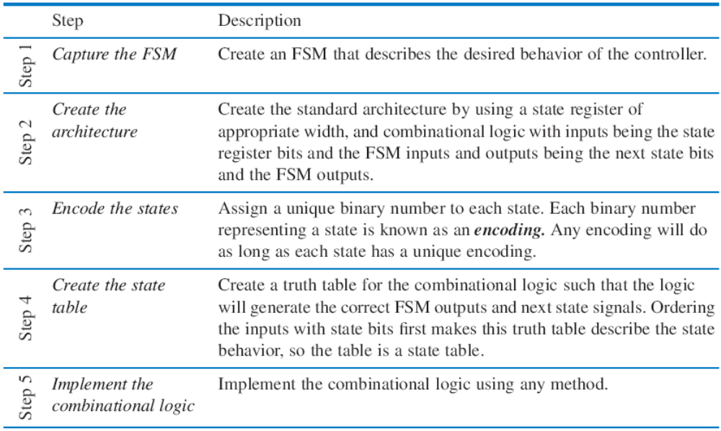
Controller Design
Five step controller design process

Slide 6
Controller Design: Laser Timer Example
Step 1: Capture the FSM
  Already done
Step 2: Create architecture
  2-bit state register (for 4 states)
  Input b, output x
  Next state signals n1, n0
Step 3: Encode the states
  Any encoding with each state unique will work
Inputs: b; Outputs: x
x=0
00
b
’
O
ff
a
b
x=1
x=1
x=1
01
On1
10
On2
11
On3
FSM
inputs
b
x
FSM
outputs
Combinational
logic
n1
n0
s1
s0
a
clk
State register

Slide 7
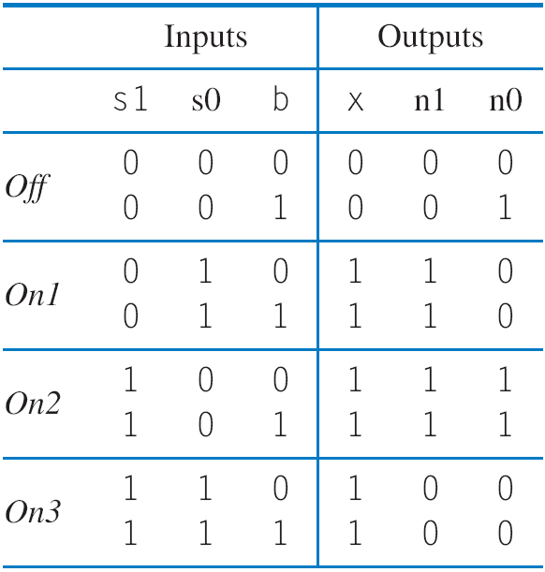
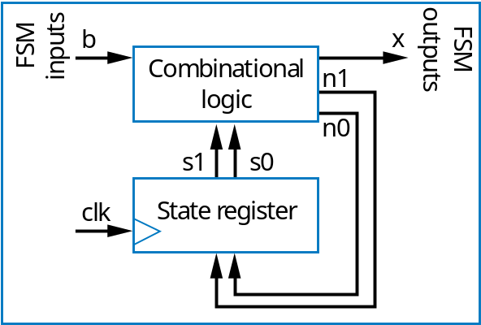
Controller Design: Laser Timer Example (cont)
Step 4: Create state table
Inputs: b; Outputs: x
x=0
00
b
’
O
ff
b
a
x=1
x=1
x=1
01
On1
10
On2
11
On3

Slide 8
Controller Design: Laser Timer Example (cont)
Step 5: Implement combinational logic
a
x = s1 + s0 (note from the table that x=1 if s1 = 1 or s0 = 1)
n1 = s1’s0b’ + s1’s0b + s1s0’b’ + s1s0’b
n1 = s1’s0 + s1s0’
n0 = s1’s0’b + s1s0’b’ + s1s0’b
n0 = s1’s0’b + s1s0’

Slide 9
Controller Design: Laser Timer Example (cont)
Step 5: Implement combinational logic (cont)
Combinational Logic
FSM outputs
b
x
n1
a
FSM inputs
n0
s1
s0
clk
State register
x = s1 + s0
n1 = s1’s0 + s1s0’
n0 = s1’s0’b + s1s0’

Slide 10
Understanding the Controller’s Behavior
x=0
x=0
x=0
00
b
’
00
b
’
00
b
’
O
ff
O
ff
O
ff
b
x=1
x=1
x=1
b
x=1
x=1
x=1
b
x=1
x=1
x=1
01
On1
10
On2
11
On3
01
On1
10
On2
11
On3
01
On1
10
On2
11
On3
b
0
x
b
0
x
b
0
x
0
0
0
1
0
0
1
1
1
0
0
1
n1
n1
n1
0
0
1
a
0
0
0
0
1
0
n0
n0
n0
0
1
0
0
0
0
clk
s1
s0
clk
s1
s0
clk
s1
s0
0
0
0
0
0
1
0
0
0
1
1
0
clk
st
a
t
e=00
st
a
t
e=00
st
a
t
e=01
I
nputs:
b
O
utputs:
x

Slide 11
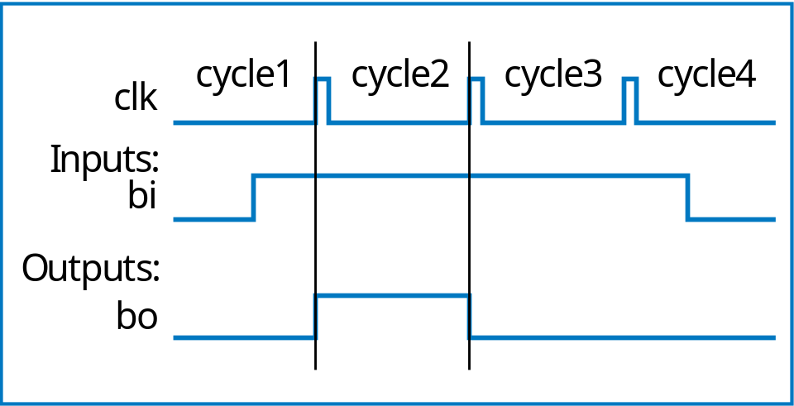
Controller Example:
Button Press Synchronizer
bi
Button press
synchronizer
controller
bo
Want simple sequential circuit that converts button press to single cycle duration, regardless of length of time that button actually pressed
  We assumed such an ideal button press signal in earlier example, like the button in the laser timer controller

Slide 12
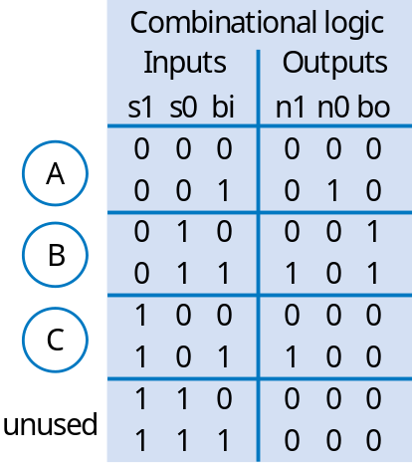
Controller Example:
Button Press Synchronizer (cont)
FSM inputs: bi; FSM outputs: bo
FSM
inputs
bi
bo
FSM
outputs
Step 2: Create architecture
Combinational
logic
bi
’
bi
n1
b
i
’
bi
’
n0
A
bi
B
bi
C
s1
s0
n1 = s1’s0bi + s1s0bi
n0 = s1’s0’bi
bo = s1’s0bi’ + s1’s0bi = s1’s0
a
bo=0
bo=1
bo=0
clk
State register
Step 1: FSM
Combinational logic
outputs
bo
bi
FSM
n1
FSM inputs: bi; FSM outputs: bo
bi
’
bi
n0
bi
’
bi
’
00
bi
01
bi
10
s1
s0
bo=0
bo=1
bo=0
State register
Step 3: Encode states
clk
Step 4: State table
Step 5: Create combinational circuit
Step 5: Create combinational circuit

Slide 13
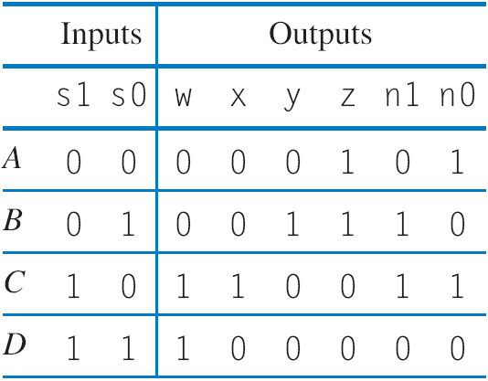
Controller Example: Sequence Generator
Want generate sequence 0001, 0011, 1100, 1000, (repeat)
  Each value for one clock cycle
  Common, e.g., to create pattern in 4 lights, or control magnets of a “stepper motor”
Inputs: none; Outputs: w,x,y,z
w
x
Inputs: none; Outputs: w,x,y,z
wxyz=0001
wxyz=1000
Combinational
logic
y
wxyz=0001
wxyz=1000
z
A
D
n1
A
00
D
11
n0
s1
s0
01
10
B
C
clk
State register
B
C
wxyz=0011
wxyz=1100
wxyz=0011
wxyz=1100
Step 1: Create FSM
Step 2: Create architecture
Step 3: Encode states
w
FSM outputs
w = s1
x = s1s0’
y = s1’s0
z = s1’
n1 = s1 xor s0
n0 = s0’
x
y
z
a
s1
s0
n0
n1
clk
State register
Step 4: Create state table
Step 5: Create combinational circuit

Slide 14

FSM Example: Secure Car Key
Many new car keys include tiny computer chip
  When car starts, car’s computer (under engine hood) requests identifier from key
  Key transmits identifier
    If not, computer shuts off car
FSM
  Wait until computer requests ID (a=1)
  Transmit ID (in this case, 1101)
Inputs: a; Outputs: r
Wait
r=0
a
a
’
K1
K2
K3
K4
r=1
r=1
r=0
r=1

Slide 15
FSM Example: Secure Car Key (cont.)
Nice feature of FSM
  Can evaluate output behavior for different input sequence
  Timing diagrams show states and output values for different input waveforms
I
nputs:
a
;
O
utputs:
r
W
ait
r=0
a
a
’
K1
K2
K3
K4
r=1
r=1
r=0
r=1
clk
clk
nputs
I
I
nputs
a
a
S
t
a
t
e
W
ait
W
ait
K1
K2
K3
K4
W
ait
W
ait
State
W
ait
W
ait
K1
K2
K3
K4
W
ait
K1
O
utputs
Output
a
r
r

Slide 16
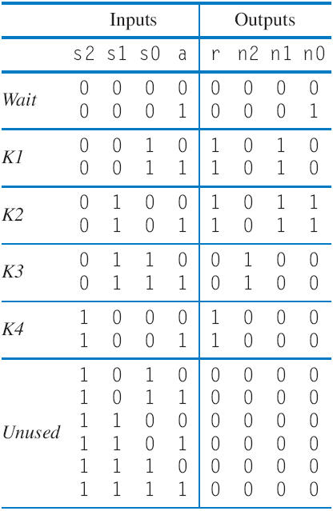
Controller Example: Secure Car Key
(from earlier example)
Inputs: a; Outputs: r
Wait
r=0
a
a
’
Step 1
K1
K2
K3
K4
r=1
r=1
r=0
r=1
a
r
Combinational
logic
n2
Step 2
n1
n0
s2
s1
s0
clk
State register
nputs:
I
a
;
O
utputs:
r
000
r=0
a
’
a
Step 3
001
010
011
100
r=1
r=1
r=0
r=1
Step 5-homework
Step 4

Slide 17
FSM Example: Code Detector
Unlock door (u=1) only when buttons pressed in sequence:
  start, then red, blue, green, red
Input from each button: s, r, g, b
  Also, output a indicates that some colored button pressed
FSM
  Wait for start (s=1) in “Wait”
  Once started (“Start”)
    If see red, go to “Red1”
    Then, if see blue, go to “Blue”
    Then, if see green, go to “Green”
    Then, if see red, go to “Red2”
      In that state, open the door (u=1)
    Wrong button at any step, return to “Wait”, without opening door
Start
s
u
Red
r
Code
Door
a
Green
g
detector
lock
Blue
b
a
Inputs: s,r,g,b,a;
Outputs: u
Wait
u=0
s
s
’
a
r
’
a
b
’
a
g
’
a
r
’
a
Start
a
’
u=0
ar
ab
ag
ar
Red1
Blue
Green
R
ed2
a
’
a
’
a
u=0
’
u=0
u=0
u=1
Q: Can you trick this FSM to open the door, without knowing the code?
a
A: Yes, hold all buttons simultaneously

Slide 18
Improve FSM for Code Detector
Inputs: s,r,g,b,a;
Outputs: u
Wait
u=0
s’
a
s
a(rb’g’)’
Start
a(gr’b’)’
a(rb’g’)’
u=0
a
’
a(br’g’)’
arb’g’
abr’g’
agr’b’
arb’g’
Red1
Blue
Green
Red2
a
’
a
’
a
’
u=0
u=0
u=0
u=1
New transition conditions detect if wrong button pressed, returns to “Wait”
FSM provides formal, concrete means to accurately define desired behavior

